Slide 1


Slide 2


Object Oriented Design and Programming (01AI0403)
Unit – 1
Introduction

Slide 3
OUTLINE
Introduction to Object Oriented Programming
Procedural Vs. Object Oriented Programming
Principles of OOP
Access Modifiers
Basics of a Typical C++ Environment
Pre-processors Directives
C++ Program structure
Header Files and Namespaces
Library files

Slide 4

Introduction to Object Oriented Programming
C++ was developed by Dr.Bjarne Stroustrup, as an extension to
the C language.
Danish computer scientist Bjarne Stroustrup began developing
the new programming language shortly after joining the technical staff at
Bell Laboratories in 1979.
C++ gives programmers a high level of control over system resources and memory. It is one of the more-challenging programming languages to apply on a large scale.

Slide 5






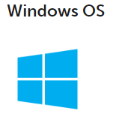


Applications
Adobe Photoshop

Slide 6




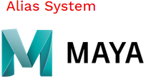




Applications

Slide 7
Applications
Real-World Applications Of C++
Games
GUI-Based Applications
Adobe Systems
Win Amp Media Player
Database Software
MYSQL Server
Operating Systems
Apple OS
Microsoft Windows OS
Browsers
Mozilla Firefox
Thunderbird
Google Applications
Advanced Computation And Graphics
Alias System
Banking Applications
Infosys Finacle

Slide 8
Applications
Real-World Applications Of C++
Cloud/Distributed System
Bloomberg
Compilers
Embedded Systems
Enterprise Software
Libraries

Slide 9
Introduction
Programmers write instructions in various programming languages to perform their computation tasks.
Programming languages allow programmers to code software.
The three major families of languages are:
Machine level Language
Assembly level Language
High level Language

Slide 10
Introduction
Machine level Language :
Machine language is the language which a CPU understands
It consists only of numbers: 0 & 1.
Example of code:
1110100010101 111010101110
10111010110100 10100011110111
Any computer can directly understand only its own machine language, defined by its hardware design.
Machine dependent
Difficult to program –one misplaced 1 or 0 will cause the program to fail.

Slide 11
Introduction
Assembly level Language :
Assembly languages are a step towards easier programming.
Similar to machine language, but use naturally understandable symbols called “Mnemonics” for numeric instructions present in the machine language.
Example:
Load 5, Load 1, Add
ADD 1001010, 1011010
It works directly with microprocessor.
Assembly language code needs to be translated to machine language before the computer processes it.
Assembly language is intermediate between high level language and machine code.

Slide 12
Introduction
High level Language :
High-level languages represent a giant leap towards easier programming.
The syntax of HL languages is similar to English.
The high-level programming languages are broadly categorized in to two categories:
Procedural oriented programming languages(POP)
Ex: C language
Object-Oriented Programming languages (OOP)
Ex. C++, Java, C#

Slide 13
Procedural Vs. Object Oriented Programming
Procedure Oriented Programming Language
In the procedure oriented approach, the problem is viewed as sequence of things to be done such as reading , calculation and printing.
Procedure oriented programming basically consist of writing a list of instruction or actions for the computer to follow and organizing these instruction into groups known as functions.

Slide 14
Procedural Vs. Object Oriented Programming
Characteristics of procedure oriented programming:
Emphasis is on doing things(algorithm).
Large programs are divided into smaller programs known as functions.
Most of the functions share global data.
Data move openly around the system from function to function.
Function transforms data from one form to another.
Employs top-down approach in program design.

Slide 15
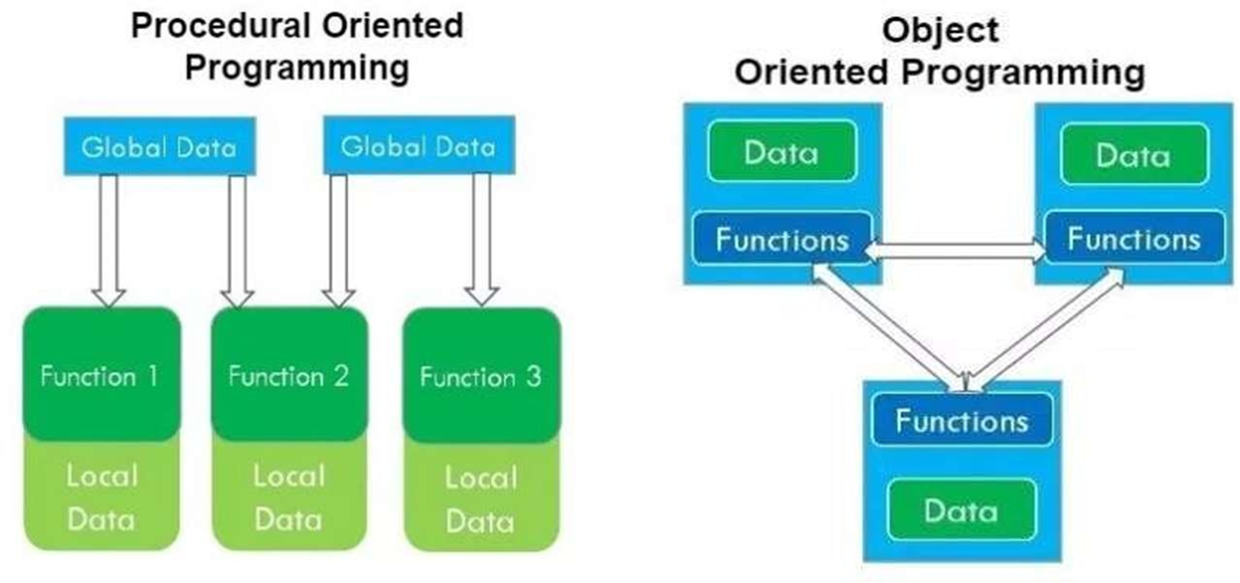
Procedural Vs. Object Oriented Programming

Slide 16
Procedural Vs. Object Oriented Programming
The disadvantage of the procedure oriented programming languages is:
Global data access
It does not model real word problem very well
No data hiding

Slide 17
Procedural Vs. Object Oriented Programming
Object Oriented Programming
Object-oriented programming (OOP) is a programming paradigm that emphasizes the concept of objects. An object is a real-world entity that has state and behavior.
In OOP, a program is designed by creating classes that represent objects, and these classes encapsulate the data and behavior of those objects.
OOP provides a way to organize complex programs by breaking them down into smaller, more manageable pieces. It also allows for code reusability and modularity, making it easier to maintain and extend code over time.

Slide 18
Procedural Vs. Object Oriented Programming
Benefits of OOPs:
OOP offers several benefits to both the program designer and user.
Through inheritance, we can eliminate redundant code and extend the use of existing classes.
The principle of data hiding helps the programmer to build secure programs that cannot be invaded by code on other parts of the program.
It is possible to have multiple instances of on object to co-exist without any interference.
It is possible to map objects in the problem domain to those objects in the program.

Slide 19
Procedural Vs. Object Oriented Programming
Benefits of OOPs: (Continued…)
It is easy to partition the work in a project based on objects.
Object-oriented systems can be easily upgraded from small to large systems.
Message passing techniques for communication between objects makes the interface descriptions with external systems much simpler.
Software complexity can be easily managed.

Slide 20
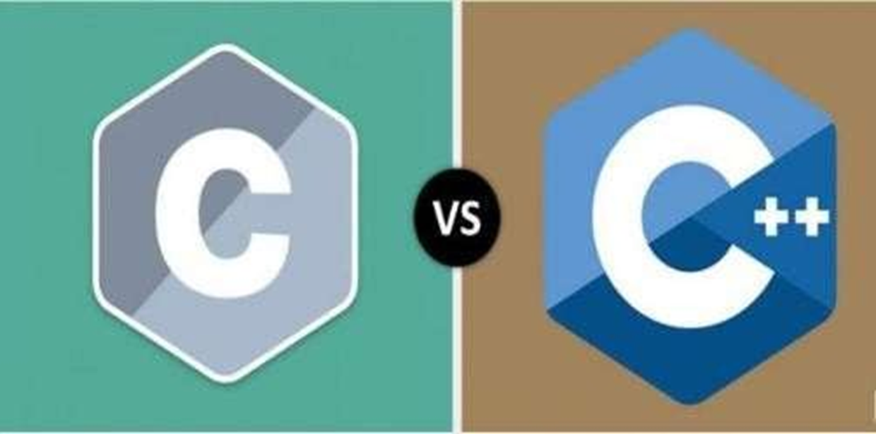
Procedural Vs. Object Oriented Programming

Slide 21
Procedural Vs. Object Oriented Programming
Parameters | POP | OOP
Basic Definition | POP is structure or procedure-oriented. | OOP is object-oriented.
Program Division | The program is divided into functions. | The program is divided into objects.
Approach | Top-down approach | Bottom-Up approach
Data Control | Every function has different data, so there’s no control over it. | Data in each object is controlled on its own.
Entity Linkage | Parts of a program are linked through parameter passing. | Object functions are linked through message passing.
Expansion | Expanding data and function is not easy. | Adding new data and functions is easy.
Inheritance | Inheritance is not supported. | Inheritance is supported in three modes: public, private & protected.
Access control | No access modifiers supported. | Access control is done with access modifiers.

Slide 22
Difference between POP and OOP
Parameters | POP | OOP
Basic Definition | POP is structure or procedure-oriented. | OOP is object-oriented.
Program Division | The program is divided into functions. | The program is divided into objects.
Approach | Top-down approach | Bottom-Up approach
Data Control | Every function has different data, so there’s no control over it. | Data in each object is controlled on its own.
Entity Linkage | Parts of a program are linked through parameter passing. | Object functions are linked through message passing.
Expansion | Expanding data and function is not easy. | Adding new data and functions is easy.
Inheritance | Inheritance is not supported. | Inheritance is supported in three modes: public, private & protected.
Access control | No access modifiers supported. | Access control is done with access modifiers.

Slide 23

Difference between POP and OOP
Example
POP
OOP
Class Car
{
char company_nm[20];
char model_nm[20];
char fuel_type[10];
float mileage;
double price;
//other code operation
}
Void main( )
{
Car Object1; Car Object2;
}
Void main( )
{
char company_nm[20]; char model_nm[20]; char fuel_type[10]; float mileage;
double price;
//other code operation
}
Company Name: Hyundai Model Name: Elite i20 Fuel Type: Petrol / Diesel Mileage: 12 km/ltr
Price: 8 lac

Slide 24
Object Oriented Programming Concepts
There are some basic concepts that act as the building blocks of OOPs.
Class
Object
Abstraction
Encapsulation
Inheritance
Polymorphism
Dynamic binding
Message Passing

Slide 25
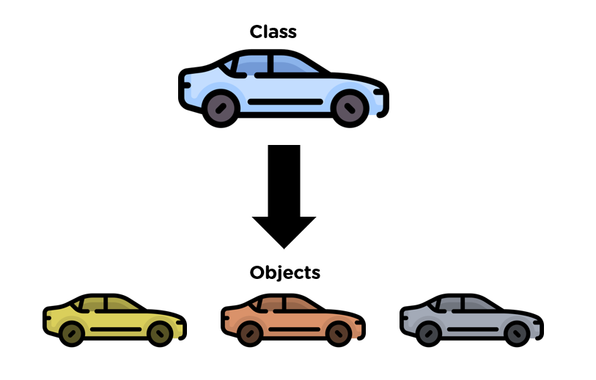
Class and objects
Class:
Class is Blueprint for any entity which defines properties and function.
It is a user-defined data type, which holds its own data members and member functions, which can be accessed and used by creating an instance of that class.
Example:
Class Name – CAR

Slide 26
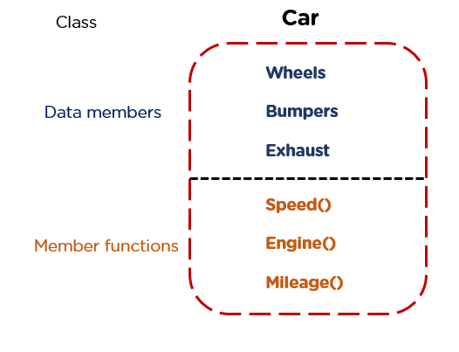
Class and objects
A class contains data members (variables) and member functions(methods). These member functions are used to manipulate the data members inside the class.

Slide 27
Class and objects
Object is real world entity or it is instance of Class.
It may be represent a person, a place, a bank account, any things, a table of data or any item that the program must handle.
When a class is defined, only the specification for the object is defined, no memory or storage is allocated.
To use the data and access functions defined in the class, we need to create objects.

Slide 28
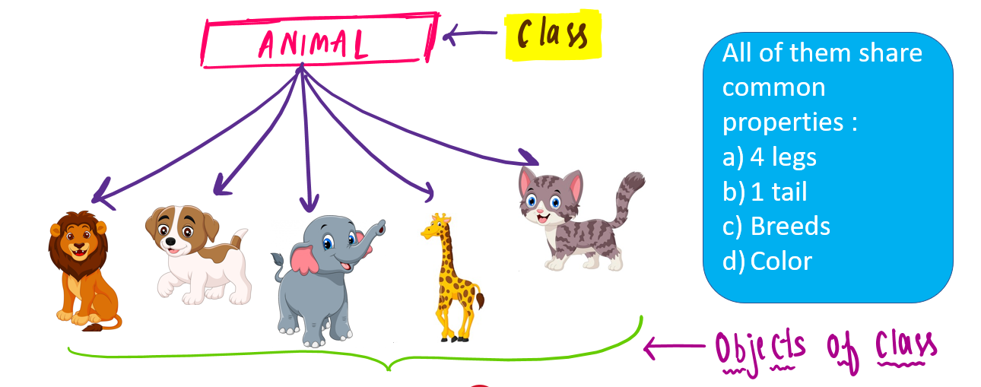
Class and objects – Example

Slide 29
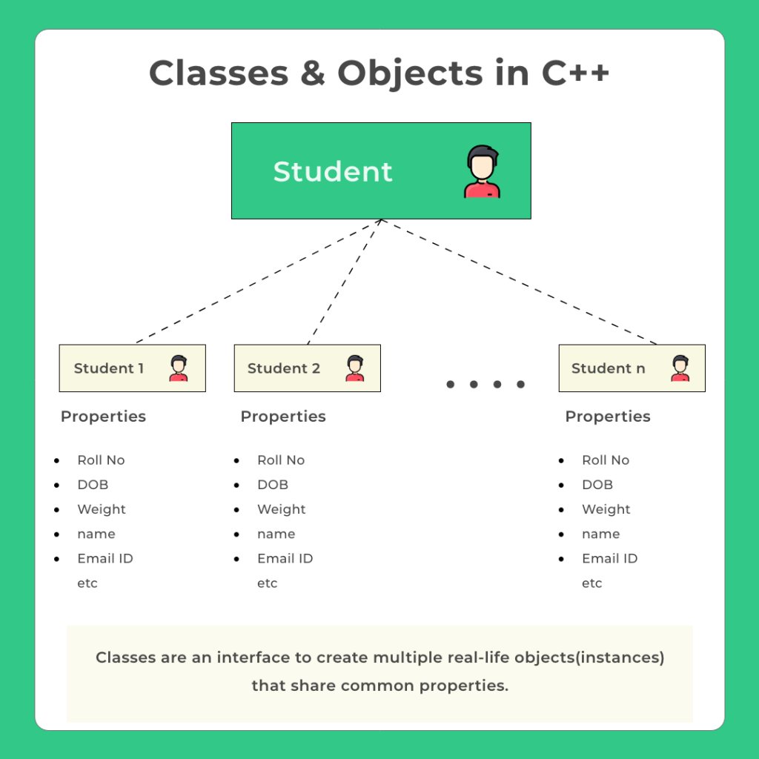
Class and objects – Example

Slide 30

Abstraction
It is a process of hiding irrelevant details from the user.
Abstraction/Data abstraction refers to providing only essential information about the data to the outside world, hiding the background details or implementation.

Slide 31
Abstraction – Example
Example – 1
Consider a real life example of a man driving a car. The man only knows that pressing the accelerators will increase the speed of car or applying brakes will stop the car but he does not know about how on pressing accelerator the speed is actually increasing, he does not know about the inner mechanism of the car or the implementation of accelerator, brakes etc in the car. This is what abstraction is.
Example – 2
The calculator shown in the figure has to be powered by a battery source. How the battery module works for the calculator is not necessary to know for the user who uses calculator.

Slide 32
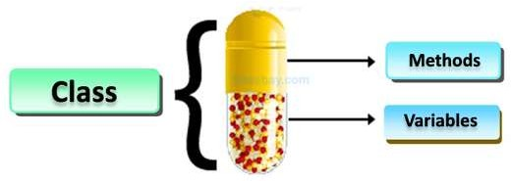
Encapsulation
The word “encapsulate” refers to the act of enclosing something, i.e Keeping the data and function into a single unit like a capsule.
Encapsulation is a process of combining data members and member functions in a single unit called class.
As in encapsulation, the data in a class is hidden from other classes, so it is also known as data-hiding.

Slide 33
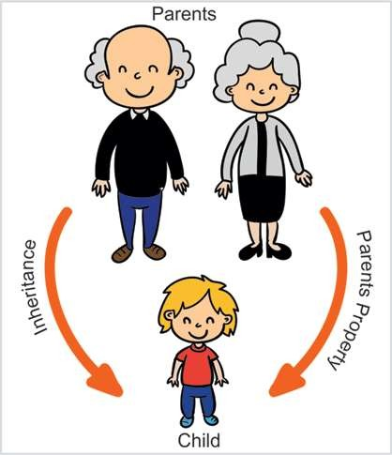
Inheritance
The capability of a class to derive properties and characteristics from another class is called Inheritance.
Inheritance is one of the most important feature of Object Oriented Programming.
There are two types of classes. They are,
Child class
Parent class

Slide 34
Inheritance
Child Class:
The class that inherits properties from another class is called sub class or derived class.
Parent Class:
The class whose properties are inherited by sub class is called base class or super class.
Real Time Example:
An insect could be represented by an Insect superclass in the animal world. Insects all have the same characteristics, such as six legs and an exoskeleton. For grasshoppers and ants, subclasses could be created. They inherently share all bug features because they inherit or are derived from the Insect class.

Slide 35
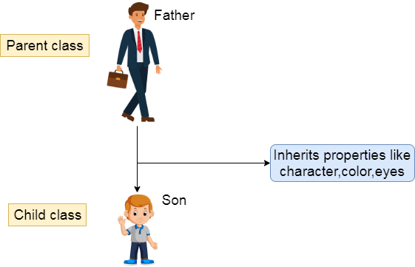
Inheritance – Example

Slide 36
Polymorphism
We can define polymorphism as the ability of a message to be displayed in more than one form.
Polymorphism in OOPs is inseparable and an essential concept of every object-oriented programming language.
An object or reference basically can take multiple forms in different instances.
As the word suggests, ‘poly’ means ‘many’ and ‘morph’ points at ‘forms’; thus, polymorphism as a whole would mean ‘a property of having many forms.’

Slide 37
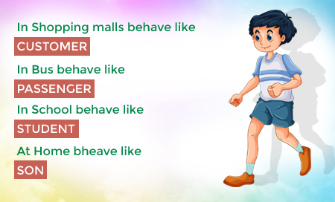
Polymorphism – Example
Person may be different form in different places.

Slide 38
Polymorphism – Types
Polymorphism in C++ is broadly classified into two categories based on their characteristic features.
Compile-time Polymorphism
Run-time Polymorphism

Slide 39
Polymorphism – Types
Compile-time Polymorphism
When the relationship between the definition of different functions and their function calls, is determined during the compile-time, it is known as compile-time polymorphism.
This type of polymorphism is also known as static or early binding polymorphism.
All the methods of compile-time polymorphism get called or invoked during the compile time.
The implementation of compile-time polymorphism is achieved in two ways:
Function overloading
Operator overloading

Slide 40
Polymorphism – Types
Runtime Polymorphism
In runtime polymorphism, the compiler resolves the object at run time and then it decides which function call should be associated with that object.
It is also known as dynamic or late binding polymorphism. This type of polymorphism is executed through virtual functions and function overriding.
All the methods of runtime polymorphism get invoked during the run time.
The implementation of run time polymorphism can be achieved in two ways:
Function overriding
Virtual functions

Slide 41
Dynamic Binding
Binding refers to the linking of a procedure call to the code to be executed in response to the call.
Dynamic Binding (also known as late binding) means that the code associated with a given procedure call is not known until the time of the call at run-time.
It is associated with polymorphism and inheritance.
A function call associated with a polymorphic reference depends on the dynamic type of that reference.

Slide 42
Message Passing
An object-oriented program consists of a set of objects that communicate with each other.
A message is a form of request that is made to an object to perform a function specific to the object to which the request was made.
A message is a form of communication between objects that make an object perform a task for the system.
Message passing in C++ is the method of communication between two or more objects.
A message is used to communicate with other objects by invoking the function of other objects.
A real-life entity modeled using the oops concept in C++ provides an example of message passing.

Slide 43
Benefits of OOPs
Through inheritance, we can eliminate redundant code and extend the use of existing classes.
The principle of data hiding helps the programmer to build secure programs that cannot be invaded by code on other parts of the program.
It is possible to have multiple instances of on object to co-exist without any interference.
It is possible to map objects in the problem domain to those objects in the program.

Slide 44
Benefits of OOPs
It is easy to partition the work in a project based on objects.
Object-oriented systems can be easily upgraded from small to large systems.
Message passing techniques for communication between objects makes the interface descriptions with external systems much simpler.
Software complexity can be easily managed.

Slide 45
Access Modifiers
Data hiding is an important concept of Object-Oriented Programming, implemented with these ‘Access modifiers’ help. It is also known as Access Specifier.
Access Specifiers in a class decide the accessibility of the class members, like variables or methods in other classes.
That is, it will decide whether the members or methods will get directly accessed by the blocks present outside the class or not, depending on the type of Access Specifier.

Slide 46
Access Modifiers
There are 3 types of access modifiers available in C++.
Private:
A private member variable or function cannot be accessed, or even viewed from outside the class. Only the class and friend functions can access private members.
Protected:
A protected member variable or function is very similar to a private member but it provided one additional benefit that they can be accessed in child classes which are called derived classes.
Public:
A public member is accessible from anywhere outside the class but within a program.

Slide 47
Access Modifiers
Syntax of Declaring Access Specifiers
class ClassName
{
private:
// Declare private members/methods here.
public:
// Declare public members/methods here.
protected:
// Declare protected members/methods here.
};

Slide 48
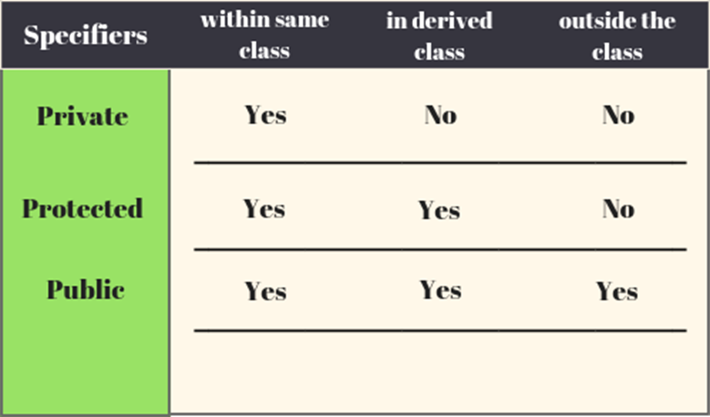
Access Modifiers
#include <iostream>
using namespace std;
class access
{
private:
int a_pri = 10;
protected:
int b_pro = 20;
public:
int c_public = 30;
};

Slide 49
Basics of a Typical C++ Environment
C++ systems generally consist of three parts: a program development environment, the language and the C++ Standard Library.
C++ programs typically go through six phases:
Editor
Preprocessor
Compilers
Linkers
Loaders
Execute

Slide 50
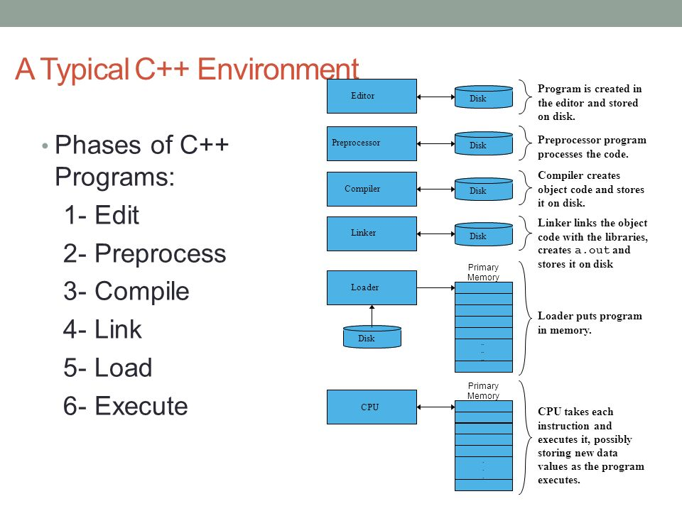
Basics of a Typical C++ Environment

Slide 51
Basics of a Typical C++ Environment
Phase 1: Creating a Program
It consists of editing a file with an editor program C++ source cod filenames often end with the .cpp extension.
In Windows: Notepad++, turbo C++, Code blocks, Visual Studio etc.
Phases 2 and 3: Preprocessing and Compiling a C++ Program
A preprocessor program executes automatically before the compiler’s translation phase begins.
The C++ preprocessor obeys commands called preprocessor directives, which indicate that certain manipulations are to be performed on the program before compilation.

Slide 52
Basics of a Typical C++ Environment
Phase 4: Linking
A linker links the object code with the code for the missing functions to produce an executable program.
Phase 5 : Loading
Before a program can be executed, it must first be placed in memory. This is done by the loader, which takes the executable program from disk and transfers it to memory.
Additional components from shared libraries that support the program are also loaded.
Phase 6 : Execution
Finally, the computer, under the control of its CPU, executes the program one instruction at a time.

Slide 53
Preprocessor directives
The preprocessor is a program that is invoked by the compiler to process code before compilation.
Commands for that program, known as directives, are lines of the source file beginning with the character #, which distinguishes them from lines of source program text.
The effect of each preprocessor directive is a change to the text of the source code, and the result is a new source code file, which does not contain the directives.
The preprocessed source code, an intermediate file, must be a valid C or C++ program, because it becomes the input to the compiler.

Slide 54
Preprocessor directives
There are 4 Main Types of Preprocessor Directives:
Macros
File Inclusion
Conditional Compilation
Other directives
Macros
Macros are pieces of code in a program that is given some name.
Whenever this name is encountered by the compiler, the compiler replaces the name with the actual piece of code.
The ‘#define’ directive is used to define a macro.

Slide 55
Preprocessor directives
File Inclusion
This type of preprocessor directive tells the compiler to include a file in the source code program.
There are two types of files that can be included by the user in the program:
Header files or Standard files:
These files contain definitions of pre-defined functions like cout(), cin(), etc.
These files must be included to work with these functions. Different functions are declared in different header files.

Slide 56
Preprocessor directives
Syntax:
#include< file_name >
2) User-defined files:
When a program becomes very large, it is a good practice to divide it into smaller files and include them whenever needed. These types of files are user-defined files.
Syntax:
#include "filename“

Slide 57
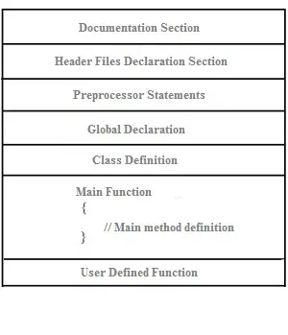
C++ Program Structure

Slide 58
C++ Program Structure
Documentation Section:
This section comes first and is used to document the logic of the program that the programmer going to code.
It can be also used to write for purpose of the program.
Whatever written in the documentation section is the comment and is not compiled by the compiler.
Documentation Section is optional since the program can execute without them.

Slide 59
C++ Program Structure
Documentation Section: (Contin..)
Comment lines are used to create the documentation.
Multiple line comment - /*……*/
Single line comment - //
Example:
/* This is a C++ program to find the factorial of a number. The basic
requirement for writing this program is to have knowledge of loops*/
// Factorial program

Slide 60
C++ Program Structure
Header Files:
Generally, a program includes various programming elements like built-in functions, classes, keywords, constants, operators, etc. that are already defined in the standard C++ library.
In order to use such pre-defined elements in a program, an appropriate header must be included in the program.
Standard headers are specified in a program through the preprocessor directive #include.
When the compiler processes the instruction #include<iostream>, it includes the contents of the stream in the program. This enables the programmer to use standard input, output, and error facilities that are provided only through the standard streams defined in <iostream>.

Slide 61
C++ Program Structure
Namespaces:
A namespace permits grouping of various entities like classes, objects, functions, and various C++ tokens, etc. under a single name.
Any user can create separate namespaces of its own and can use them in any other program.
In the below snippets, namespace std contains declarations for cout, cin, endl, etc. statements.
using namespace std;

Slide 62
C++ Program Structure
Definition Section:
It is used to declare some constants and assign them some value.
In this section, anyone can define your own datatype using primitive data types.
In #define is a compiler directive which tells the compiler whenever the message is found to replace it with “Factorial\n”.
typedef int INTEGER; this statement tells the compiler that whenever you will encounter INTEGER replace it by int and as you have declared INTEGER as datatype you cannot use it as an identifier.

Slide 63
C++ Program Structure
Global Declaration Section:
Here, the variables and the class definitions which are going to be used in the program are declared to make them global.
The scope of the variable declared in this section lasts until the entire program terminates.
These variables are accessible within the user-defined functions also.

Slide 64
C++ Program Structure
Function Declaration Section:
It contains all the functions which our main functions need.
Usually, this section contains the User-defined functions.
This part of the program can be written after the main function but for this, write the function prototype in this section for the function which for you are going to write code after the main function.

Slide 65
C++ Program Structure
Main Function:
The main function tells the compiler where to start the execution of the program.
The execution of the program starts with the main function.
All the statements that are to be executed are written in the main function.
The compiler executes all the instructions which are written in the curly braces {} which encloses the body of the main function.
Once all instructions from the main function are executed, control comes out of the main function and the program terminates and no further execution occur.

Slide 66
Library functions in C++
Headers | Description
iostream | This header contains the prototype for standard input and output functions used in C++ like cin, cout, etc.
cmath | This is the header containing various math library functions.
iomanip | This header contains stream manipulator functions that allow us to format the stream of data.
cstdlib | The header cstdlib contains various functions related to conversion between text and numbers, memory allocation, random numbers, and other utility functions.
ctime | ctime contains function prototypes related to date and time manipulations in C++.
cctype | This header includes function prototypes that test the type of characters (digit, punctuation, etc.). It also has prototypes that are used to convert from uppercase to lowercase and another way around.

Slide 67
Library functions in C++
Headers | Description
cstring | cstring header includes function prototypes for C-style string-processing functions.
cstdio | This header contains function prototypes for the C-style standard input/output library functions which we included initially in stdio.h
fstream | Function prototypes for functions that perform input/output from/to files on disk are included in fstream header.
climits | climits header has the integral size limits of the system.
cassert | cassert header contains macros and variables for adding diagnostics that help us in program debugging.
cfloat | This header file contains the size limits for floating-point numbers on the system.
string | The header string defines the class string of the C++ Standard Library.

Slide 68


